Slide 1
Group Politics and Stakeholder Engagement with Gene Drive Technology
Kalina Kamenova, PhD
Founder and Research Director
Canadian Institute for Genomics and Society
Notes:
Gene drive research has incited intense interest from governments, philanthropists and global health organizations, and there are efforts under way to deploy gene drive-modified mosquitoes in the first open field trials to eradicate malaria in Africa. There is nonetheless a fierce public opposition to the possibility of direct genetic modification of species in the environment. Environmental activists, anti-GMO groups and some governments have pushed for a global moratorium on gene drive research and its applications, warning against deliberate extinctions of wild populations and negative impacts on ecosystems. In this talk, I will present a brief overview of the techno-scientific controversy, attempt to map the dynamics of group politics in the development of technology, and discuss normative criteria for public engagement in decision-making.

Slide 2
Overview
What is “gene drive”?
Potential applications of gene drive technology
Push to deploy gene drives to eradicate vector-borne diseases
Group politics in this scientific controversy
PR “wars” over transparency and expert consensus
Normative considerations for public engagement

Slide 3
1. What is gene drive?
Notes:
Gene drive technology relies on the use of CRISPR/Cas9, a revolutionary gene editing method, which allows for genes to be deleted, modified, or inserted in such a way that the altered gene is always inherited in the offspring.

Slide 4
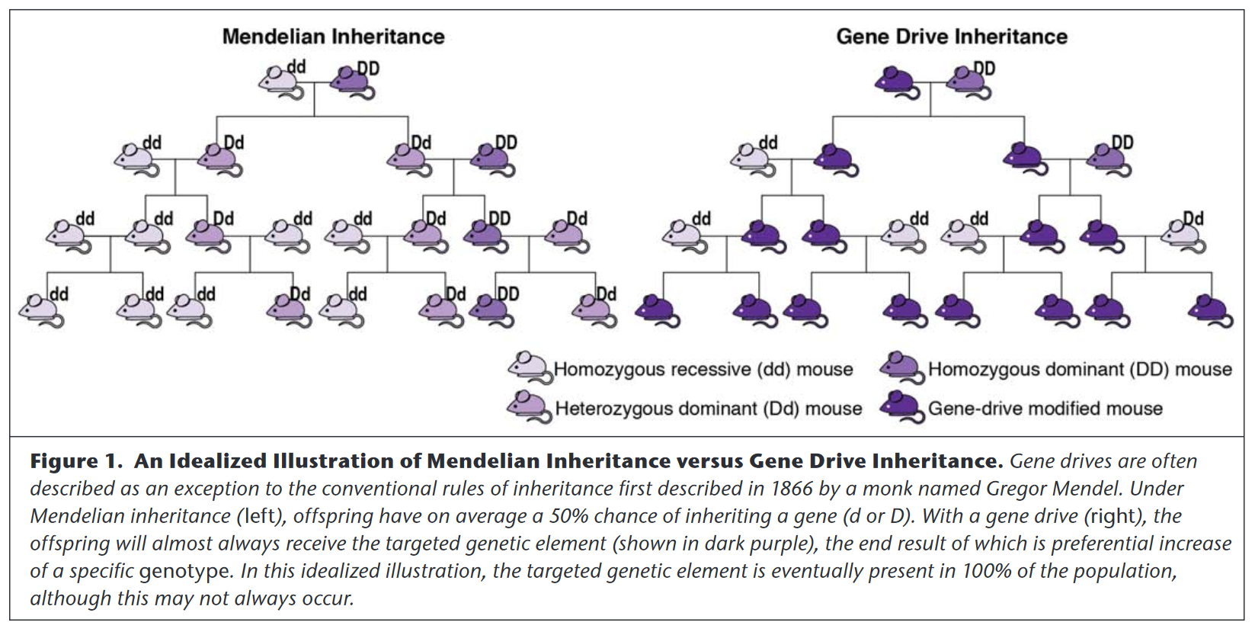
Gene drives are systems of biased inheritance that enhance the ability of a genetic element to pass from an organism to its offspring through sexual reproduction.
Source: NASEM Report Gene Drives on the Horizon: Advancing Science, Navigating Uncertainty, and Aligning Research with Public Values (July 8, 2017)
Notes:
Gene drives are systems of biased inheritance that enhance the likelihood a sequence of DNA passes between generations through sexual reproduction and potentially throughout a local population and ultimately all connected populations of a species. It’s a genetic engineering technology that allows to quickly modifying specific populations and even entire species directly into the environment.

Slide 5
Proof-of-concept studies of CRISPR/Cas9 gene drive systems in insects
Population suppression or population elimination
Population modification (e.g., replacement of disease transmitting mosquitoes with disease-refractory ones)
Notes:
Recent small-scale proof-of-concept models of gene drives in insects have demonstrated the ability to quickly supress or modify disease bearing mosquito populations, thus raising hopes for global efforts to eliminate and eradicate vector-borne diseases such as malaria, dengue, yellow fever, chikungunya, and Zika. The first experiment published in Nature Biotechnology in 2015 targeted female reproduction in the malaria mosquito to suppress mosquito populations to levels that do not support malaria transmission. In the second case, mosquitoes were engineered to be resistant to the malaria parasite Plasmodium falciparum and not transmit it to humans.

Slide 6
2. Potential applications
Notes:
Gene drives have promising applications in at least three areas – biomedicine, agriculture, and for bioconservation. In addition to the potential to eradicate vector-borne diseases, CRISPR-based gene drives can provide solutions for sustainable agriculture such as the reversal of pesticide and herbicide resistance and more efficient pest control to help increase crop productivity. Additionally, the technology has promising applications in bioconservation and can help with the eradication of invasive species that undermine global biodiversity.

Slide 7
Framing the promise of gene drive technology in media discourse (Kamenova et al., 2017)
Notes:
Other uses have included: bioterrorism, engineering algae as a source of biofuel, helping cope with climate change, in farming and food industry, to develop genetically engineered bacteria to eat oil spills, to bring back extinct species, to target human cells that carry mutated genes (e.g., cancer cells and HIV), to fight human diseases.

Slide 8
Major health benefits of gene drive technology (n=143)

Slide 9
3. Push to deploy gene drives to eradicate malaria

Slide 10
Malaria as a Global Health Problem: WHO key facts
Despite being preventable and treatable, malaria is estimated to have caused 438,000 deaths in 2015, a rate of about 1,200 deaths every day
70% of these are children less than 5 years old
3.4 billion people (half the world’s population) are at risk for malaria
Current interventions such as drug treatments, bed nets and insecticide spraying are often ineffective and expensive to maintain
The WHO Global Technical Strategy for Malaria 2016–2030 estimates that these approaches requires US$5.1 billion per year
The funds required to fight malaria have been predicted to rise to $9 billion per year by 2030
Notes:
Malaria is a mosquito-borne infectious disease caused by Plasmodium parasites transmitted by the infectious bite of Anopheles mosquitoes. Vector control of malaria has predominantly focused on targeting the adult mosquito through insecticides and bed nets. However, current vector control methods are often not sustainable for long periods, so alternative methods for vector control are needed.

Slide 11
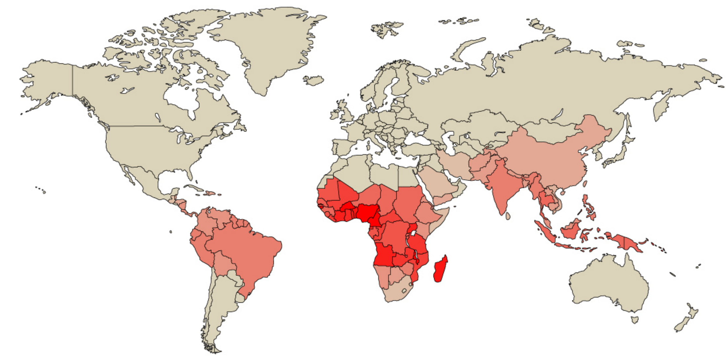
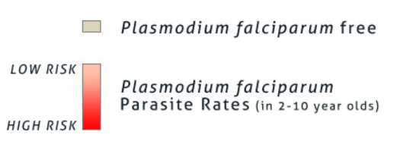
Disease Endemic Countries
90% of the all malaria-related deaths occur in sub-Saharan Africa, where domestic resources are least available to fight the disease
13 countries, mainly in sub-Saharan Africa, account for 76% of malaria cases and 75% deaths globally
Notes:
Because the disease is prevalent in poor countries, it doesn’t get much investment. As Bill Gates pointed out in a 2017 TED talk, there’s more money put into baldness drugs then into malaria.

Slide 12
Experimental approaches approved by WHO
Sterile Insect Technique (SIT) - males of a target species are harvested, irradiated or chemically treated to induce sterility, and then released in numbers that overwhelm the local population (e.g., the successful eradication of the screw worm fly in the 1960s)
Wolbachia-infected mosquitoes – uses the maternally inherited alpha-proteobacterium Wolbachia, which interferes with disease transmission and lifespan of mosquitoes by creating cytoplasmic incompatibility (i.e. eggs and sperm are unable to form viable offspring). Field tests in Australia, Brazil, Vietnam, and Malaysia have demonstrated the potential of this approach to reducing dengue and other Aedes-borne disease.
Genetically modified (GM) or transgenic male mosquitoes – open release to suppress the wild population
Notes:
SIT has been applied to flies, beetles, and mosquitos with many successes and not a few failures. For the US, the most notable application of SIT was the successful eradication of the screw worm fly (which can cause billions of dollars in livestock losses) in the 1960s. Current programs, primarily sponsored through the UN, include attempts to eradicate the tsetse fly in primarily African countries, such as Senegal. SIT approaches are a more brute force approach and have the greatest success when the habitat area is small, the population density is relatively low, the target species does not have a large migratory range and is it not adaptable to diverse habitats (Gould 2008).
The Eliminate Dengue Program, for example, is not trying to reduce the overall number of mosquitoes. It aims is to spread Wolbachia into wild mosquito populations to reduce the ability of these mosquitoes to transmit disease. The method does not involve genetic modification (GM), as the genetic material of the mosquito has not been altered. http://www.eliminatedengue.com/faqs/index/type/our-research#sthash.MSWm4pL0.dpuf

Slide 13
Investment by Global Philanthropic Organizations
The Bill & Melinda Gates Foundation has provided $75 million to Target Malaria, an international multi-disciplinary consortium based at the Imperial College in London.
Target Malaria is currently preparing for the first field test of gene drive technology - an open release of gene-drive modified Anopheles gambiae mosquitoes, the main malaria vector in Africa, in Burkina Faso.
India’s Tata Trusts also invested $70 million to create the Tata Institute for Active Genetics and Society in collaboration with the University of California-San Diego in the US and the Institute for Stem Cell Biology and Regenerative Medicine (InStem) in Bengaluru.
Notes:
The BMGF aims to have gene-drive ready for deployment by 2023, however, in a media interview in 2016, Bill Gates made a rather optimistic prognosis that gene drive technology would be available for wide use in just two years.

Slide 14
4. Group politics in this scientific controversy

Slide 15
Key actors advocating deployment of gene drives
Bill & Melinda Gates Foundation
Target Malaria
Emerging Ag Inc. (Canadian PR Firm)
U.S. Government
The U.S. Defense Advanced Research Projects Agency (DARPA)
National Institutes of Health (NIH) and Foundation of the National Institute of Health (FNIH)
Developers and African governments
Scientists, research institutes receiving funding
The Outreach Network for Gene Drive Research
The African Union (AU)
Agri-research bodies and companies
Notes:
Current members of the Outreach Network are Island Conservation (a Genetic Biocontrol of Invasive Rodents partner), Target Malaria, the Wellcome Trust, the Bill & Melinda Gates Foundation, Ifakara Health Institute, the UCI Malaria Initiative, McMaster Institute on Ethics & Policy for Innovation, and Malaria No More. The African Union previously opposed gene drives, but endorsed technology in July 2018

Slide 16
Key actors opposing gene drive technology
Calls for a moratorium on releases of gene drive organisms during the Convention on Biological Diversity (CBD)’s meeting in November 2018 in Egypt, led by Bolivia and Venezuela, supported by African countries such as Egypt and Morocco.
The ETC Group and Friends of the Earth are the two anti-GMO groups most vocally opposed to gene drive research.
Joint statement with The Alliance for Food Sovereignty in Africa stated: “In Africa we are all potentially affected, and we do not want to be lab rats for this exterminator technology. Farmers have already marched in the streets of Burkina Faso to protest genetically engineered mosquitoes and we will march again if they ignore this UN decision.”
Notes:
Ban on ‘gene drives’ has been consistently on the UN’s agenda. Ultimately, the parties to the Convention on Biological Diversity (CBD)—a treaty meant to protect vulnerable ecosystems and ratified by every country but the US and Vatican City—decided against a moratorium.

Slide 18
5. PR “wars” over transparency and expert consensus

Slide 19
The WikiLeaks of Gene Drive Research
http://genedrivefiles.synbiowatch.org/
Notes:
The Gene Drive Files consist of records released in response to US and Canadian open records requests. The bulk of the files are from North Carolina State University, and were released on 27 October 2017 under a request by Edward Hammond/Third World Network. The files also include records from Texas A&M University, also requested by Edward Hammond/Third World Network and released on 21 August 2017 (Request TAMU R001428). Additional earlier records are included from an Access to Information request filed by ETC Group in 2016 with the Canadian Food Inspection Agency.

Slide 20
Manufacturing expert and scientific consensus
Emerging Ag covertly co-ordinated a network of public researchers and officials in an attempt to influence the Convention on Biological Diversity (CBD).
It recruited over 65 experts in an attempt to direct their input into the official UN process. A senior official in the Gates Foundation and government and university scientists were involved in this concealed coordination effort.
The influence operation closely involved three members of the Ad Hoc Technical Expert Group on Synthetic Biology, with two of these representing institutions that received over $100 million dollars combined in U.S. military and philanthropic funds expressly to develop and test gene drive systems.

Slide 21
Gates Foundation’s Response: The Outreach Network for Gene Drive Research
Notes:
Current members of the Network are Island Conservation (a Genetic Biocontrol of Invasive Rodents partner), Target Malaria, the Wellcome Trust, the Bill & Melinda Gates Foundation, Ifakara Health Institute, the UCI Malaria Initiative, McMaster Institute on Ethics & Policy for Innovation, and Malaria No More. They are managed by Emerging Ag Inc.

Slide 22
6. Normative considerations for public engagement

Slide 23
Is gene drive technology becoming a new form of medical colonialism?
Africa is becoming the testing ground for gene drive technology, yet the voices and perspectives of local communities are rarely represented in deliberations on global health policy
E.g., Global Health Summit in October 2018 – The WHS Global Health Security Panel had no representatives from the region
In high-level public and policy forums on gene drive technology, voices from the Global South are underrepresented or supressed
In the Global South, especially African countries, there have not been sustained efforts for open public dialogue regarding open release of gene-drive modified organisms

Slide 24
Questions/comments?

