Slide 1
Are Ethical Qualms over Embryonic Stem Cells still Relevant? Media Hype, Public Perceptions and the Social Acceptance of Stem Cell Research in Canada
Kalina Kamenova, PhD
Institute on Ethics & Politics for Innovation (IEPI)
Faculty of Humanities, Department of Philosophy
McMaster University, Canada

Slide 2
Social context and policy options
Human stem cell research has been characterized by policy “exceptionalism”
Stem cell-specific policies have been effective in ensuring the development of ethically responsive research internationally
Calls to align stem cell research with biomedical research policy (“Normal Science” solution)

Slide 3
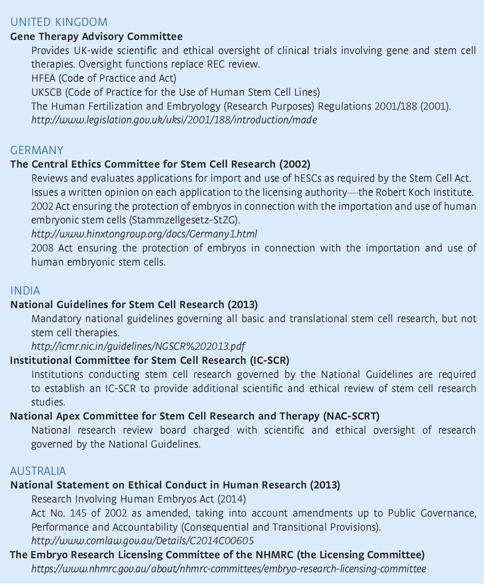
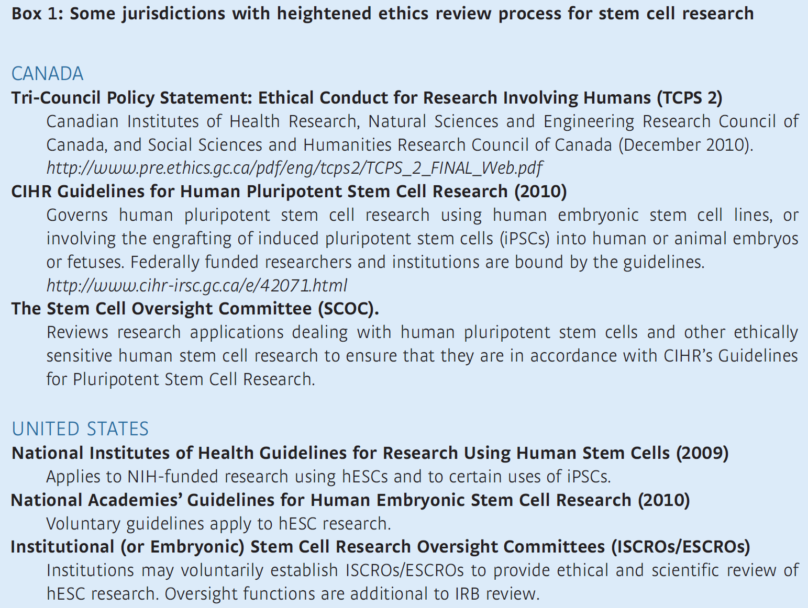

Slide 4
Stem Cell Oversight Committee (SCOC)
Application review: 2012-2013
# of applications

Slide 5
Since inception (2004)
# of applications

Slide 6
Clinical translation of stem cell therapies in the print news media from January 1, 2010 to December 31, 2013
How advances in translational stem cell research and timelines for realizing its promise were portrayed
Analyzed comparatively the media coverage before and after Geron’s decision to terminate its stem cell program

Slide 7
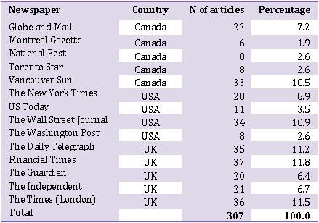
Methods
Quantitative content analysis
Coded for mentions of clinical trials, timelines, who was cited about timelines, types of stem cells discussed, mentions of Geron’s clinical trials, major theme, and the overall perspective on SCR
Two data sets were analyzed comparatively
160 news reports from Jan 1, 2010 to Nov 13, 2011 (“pre-Geron” coverage)
133 news reports from Jan 1, 2012 to Dec 31, 2013 (“post-Geron” coverage)
Newspapers in data set (n=307)

Slide 8
The focus of media coverage has shifted from ELSI stories to clinical translation
37.1% focused on clinical translation
22.8% reported advances and new discoveries in the field
11.4% discussed funding and regulatory issues
11.1% general discussions of the potential of SCR and RM
14% addressed other concerns (e.g., cosmetic treatments with SCs, use of stem cells in the food industry, etc.)
Only 1.6% focused exclusively on ethical issues
Suggestive of the normalization of the field

Slide 9
Less emphasis in media coverage on stem cells from embryonic sources
Only 21.5% of the articles reported exclusively about hESCs
hESCs had dominated discussions in the US press in the early years of discovery (1998 – 2000) and in 2001 when the controversy reached its political peak (Nisbet et al., 2003)
A study of 13,249 articles in English-language newspapers between 1991 and 2010 showed that coverage from 1998 to 2010 had focused mainly on hESCs (Bubela et al., 2012).

Slide 10
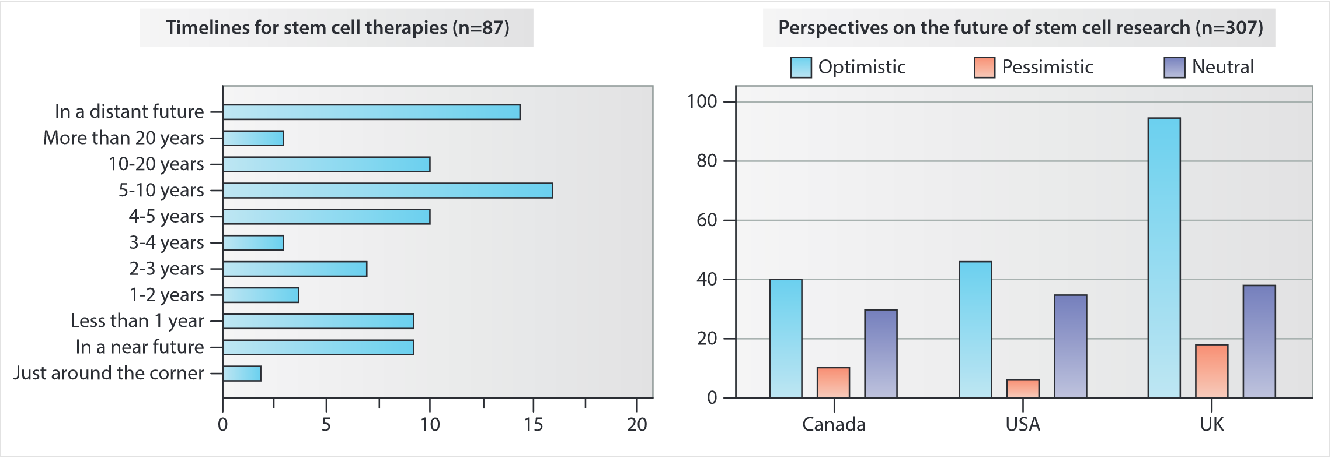
Media hype and the future of stem cell research

Slide 11
Some conclusions
The media discourse is not an accurate reflection of the actual state of translational SC research
most clinical trials over the past decade have used SCs for the treatment of cancer and graft -versus-host disease, media coverage has focused extensively on applications for neurological conditions, cardiovascular diseases, and diabetes
The overly optimistic slant in media coverage may have an impact on public expectations regarding the speed of clinical translation
Questions about the role of stem cell researchers in science communication
Ethical responsibility to convey realistic timelines to the popular press

Slide 12
Thank you!
Questions/Comments?

