Slide 1
INTO THE UNKNOWN: A Study of Media Portrayal of Gene Drive Technology
Kalina Kamenova, PhD
Talking About Gene Drive: Communications Workshop
Baltimore, November 4, 2017

Slide 2
Study Objectives
Systematic content analysis of media coverage gene drive technology between January 1, 2015 and December 31, 2016
To look at potential implications of this portrayal, particularly how risks associated with the release of gene drive-modified organisms in the environment were framed
To establish the major themes and issues discussed in the news stories and whether media is hyping the promise of gene drive research

Slide 3
Methods
Selection
Searches on the Factiva database
Coding
Development of framework for content analysis
Central theme; how gene drives were defined; health and environmental benefits and risks; ethical concerns, policy issues; overall tone and the use of emotive, sensational language
Analysis
Statistical analysis using SPSS to establish frequencies for each category
Interpreted the findings in the context of past research on media representations of genetic science and biomedical research
145 relevant articles
Keywords: gene drive, genetically modified mosquitoes, malaria, Zika, dengue, chikungunya
Notes:
News sources included print and online editions of major newspapers, online newsletters, popular magazines, online news, and radio and TV broadcast transcripts.
Articles were considered relevant if their central theme was gene drives or there were substantive discussions about the technology and its impact such as scientific aspects, ethical and policy issues, environmental impacts, public perceptions and engagement, regulatory oversight, public health considerations, related scientific developments, economic considerations, or social factors that can influence adoption.

Slide 4
Coding Categories & Sample Questions
The coding book included 34 questions, divided into three thematic sections:
I. Perceived attributes and applications of gene drive technology
II. Ethical, legal and social implications (ELSI)
III. Attitudes towards gene drive technology
Question 5: What potential applications of gene drive technology are mentioned in the article?
Question 23: Does the article mention policy gaps and practical challenges arising from the potential deployment of gene drive technology?
Question 34: Does the article use emotionally laden or sensationalist language to describe gene drive technology and GM mosquitoes in general?

Slide 5
Inter-coder Reliability Assessment
Inter-coder reliability assessment using Cohen’s kappa (κ) was conducted
Independent researcher coded 10 percent of the news reports in our data set (n = 15)
Kappa (κ) scores on most coding categories indicated substantial or almost perfect inter-rater agreement, based on Landis and Koch’s (1977) benchmark standards for interpreting kappa

Slide 6
Results
Content analysis of news reports on gene drive technology

Slide 7
Media Sources

Slide 8
News Coverage by Country
Country | Number of articles | Percentage in data set
United States United Kingdom Canada Australia New Zealand Ireland India Sri Lanka Jordan South Korea Uganda Oman Qatar Pakistan Thailand Singapore South Africa Japan Total | 76 | 52.4
 | 30 | 20.7
 | 2 | 1.4
 | 12 | 8.3
 | 7 | 4.8
 | 1 | .7
 | 5 | 3.4
 | 1 | .7
 | 1 | .7
 | 1 | .7
 | 1 | .7
 | 1 | .7
 | 1 | .7
 | 1 | .7
 | 2 | 1.4
 | 1 | .7
 | 1 | .7
 | 1 | .7
 | 145 | 100.0
Most discussions of gene drive technology occurred in the US and UK media
Limited or no coverage in countries/regions where the technology will be deployed

Slide 9
Publications in major US and UK Newspapers
Notes:
Here are some examples of publications in major daily newspapers in the US and UK. Some of these like The New York Times, The Washington Post, USA Today, The Guardian, The Independent, and The Times are influential and prestigious newspapers, distributed nationwide and internationally. Frequent coverage in these news sources can make an issue salient in the public discourse and potentially elevate it to the top of national political agenda.

Slide 10
Potential Applications of Gene Drive Technology
For bioterrorism
To engineer algae as a source of biofuel
To help cope with climate change
In farming and food industry
To develop genetically engineered bacteria to eat oil spills
To bring back extinct species
To target human cells that carry mutated genes (e.g., cancer cells and HIV)
To fight human diseases

Slide 11
Perceptions of Risks

Slide 12
Who Was Cited
51% of the articles cited experts on the high level of risks:
28% scientists
7% environmental and genetic watchdog organizations
6% policy and ethics experts
3% government representatives
3% journalists
1% industry representatives
1% philanthropists
1% others

Slide 13
Readiness of the technology
Gene drives were portrayed as a technology that is still in an experimental phase, not safe, and not ready for deployment in field trials

Slide 14
Major Themes in News Coverage
(e.g., new discoveries in science, the Zika crisis, UK company Oxitec, regulation of GM mosquitoes, and miscellaneous topics)
Notes:
The two events that received most coverage in the press were: the NASEM report Gene Drives on the Horizon released in July 2016 and the 13th Meeting of the Conference of the Parties to the Convention on Biological Diversity (CBD) held in Cancun, Mexico in December 20, 2016.

Slide 15
Ethical Objections
Environmental release of gene-drive modified organisms could lead to unanticipated public health and environmental harms (28%)
Deployment of gene drives is unethical because nature has intrinsic value and it is immoral to undermine the balance of the natural world (18%)
“Sanctity of life” and “playing god” arguments (17%)
Objections based on “slippery slope” (3%)

Slide 16
Policy and practical considerations
the need for international safeguards to ensure biosafety in labs
greater transparency and more funding for research on potential risks
concerns about commercial pressures to deregulate gene-editing techniques
that effects on the specific species and their ecosystems need to be carefully examined and monitored
that instructions for making gene drives should be classified
that a broader moral consensus on genetic modification is needed before implementing gene drive technology;
that media have consistently failed to educate the public about the risks of genetic technologies
the need to build long-term relationships with scientists in low and middle income countries

Slide 17
Health Benefits

Slide 18
Health Risks
Favorable portrayal of potential use of gene drives for public health interventions, with a greater emphasis on health benefits (90%) vs risks (31%)

Slide 19
Environmental Benefits
(e.g., eliminating the use of insecticides, reversing negative impacts from past human activities on ecosystems, genetically engineered bacteria to eat oil spills, developing new ways to interact with nature, and removing genetic defenses that allow some weeds to resist herbicides)

Slide 20
Environmental risks
Environmental applications were viewed less favorably, with a greater emphasis on environmental risks (60%) vs benefits (40%)
(e.g., fears about cross-breeding of GM mosquitos; that GM larvae will damage and contaminate the crop; that a pathogen would adapt and becomes endemic in a different species; that suppression of undesirable organisms may lead to the emergence of others that are worse; that another harmful species might take the place of mosquitoes; that altered genes might escape into another species; and that gene drives may cause extinctions)

Slide 21
Tone of Media Coverage
Positive – gene drive technology was represented in a positive light, focusing on benefits
Negative – gene drive technology was represented in a negative light, emphasizing risks associated with its deployment
Descriptive/neutral – narratives that do not include evaluative statements ( e.g., reporting scientific discoveries, describing potential applications without assessments of potential benefits vs. risks)
Balanced - both benefits and risks arising from potential uses were accurately presented and discussions were substantive (e.g., supported with investigative evidence, references to scholarly perspectives, and expert opinion)

Slide 23
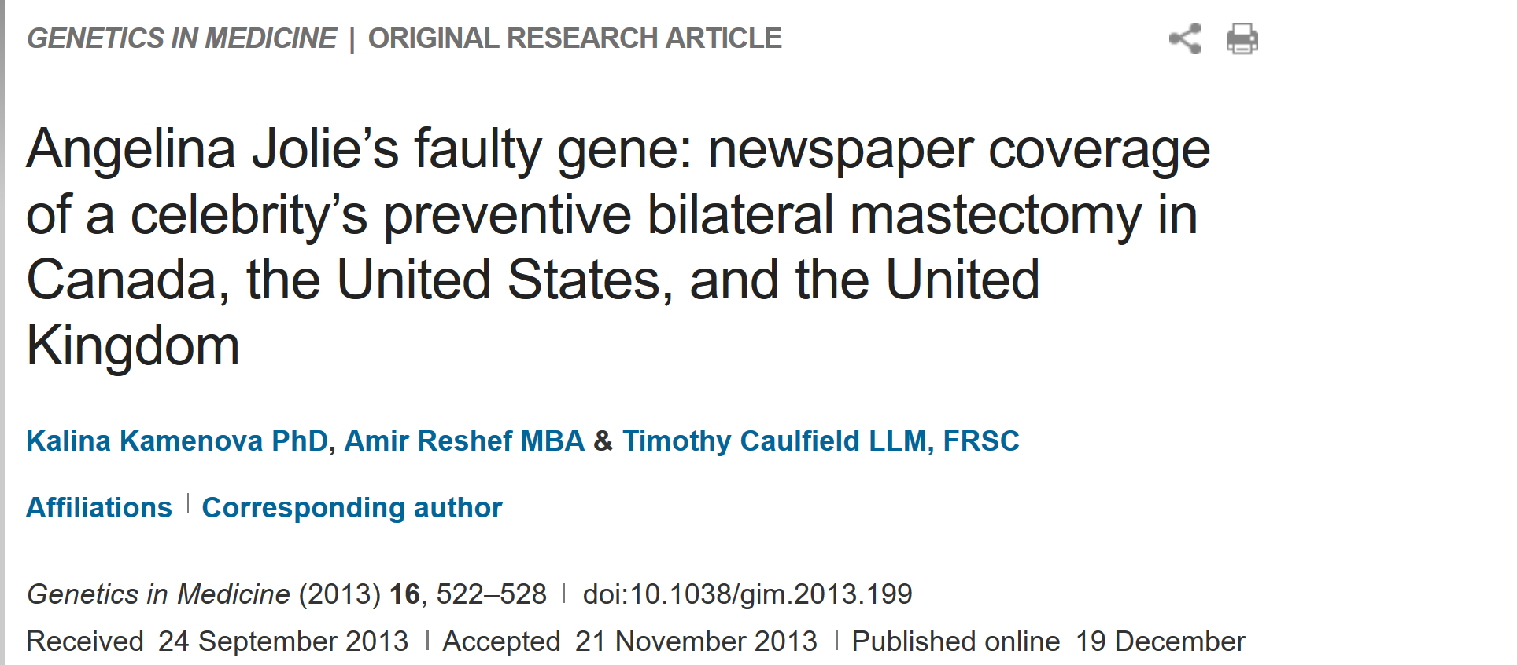
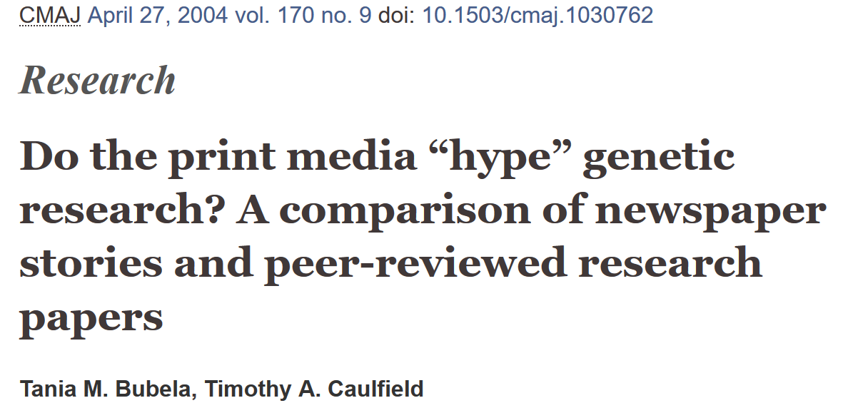
Sensationalism in Media Representations
Positive hype
Negative hype
Exaggerating potential benefits; unsubstantiated claims regarding clinical applications; unrealistic timelines for implementation
Exaggerating risks; technology as Frankenstein’s monster; concerns about opening Pandora’s box and playing God
Genohype – excessive preoccupation with genetic medicine and its inaccurate portrayal

Slide 24
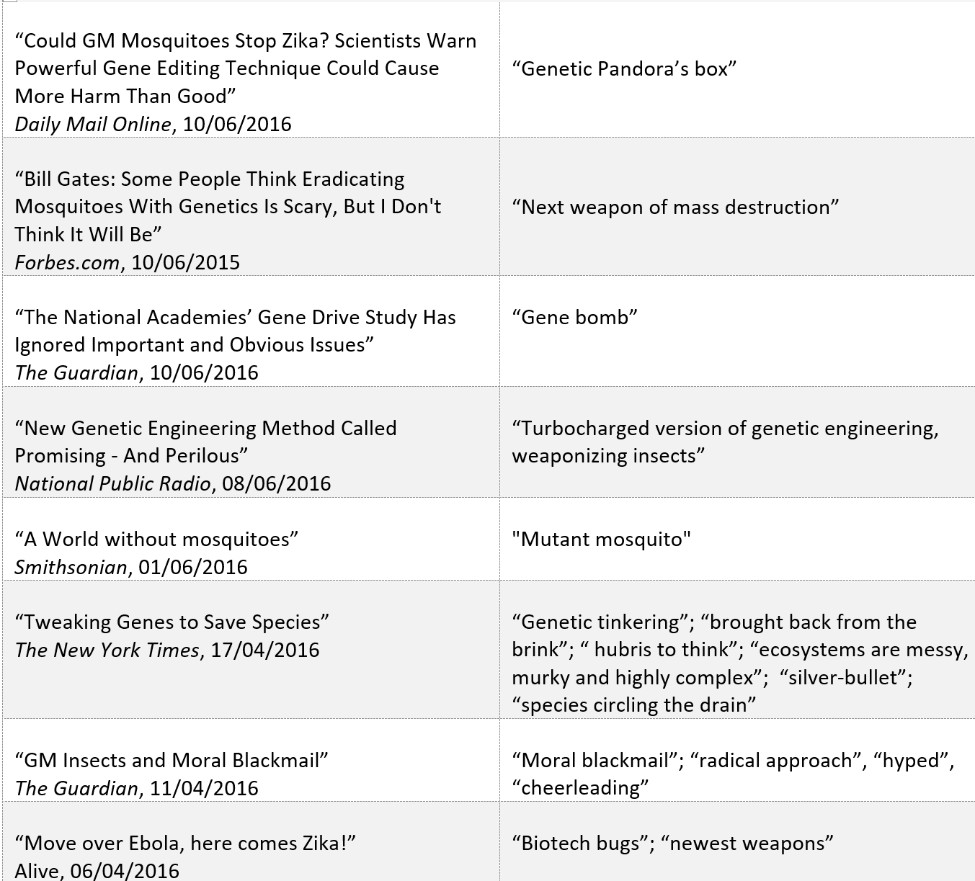
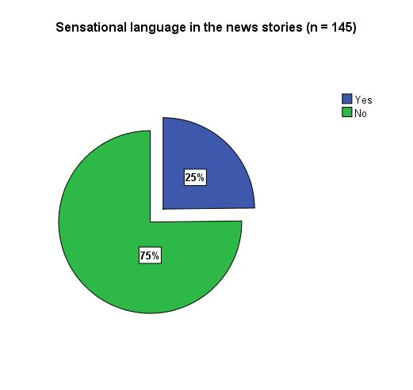
Negative sensationalism was prevalent in the media portrayal of gene drives

Slide 25
Analysis
Media coverage on gene drive technology

Slide 26
Summary of Findings
Media portrayal of gene drive technology was favorable, with only 12% of the news reports using a negative tone
Discussions have tended to be balanced and nuanced, rather than driven by unwarranted optimism and unrealistic expectations
There were, however, some examples of negative hype that can potentially instill fear about the technology

Slide 27
Conclusions
Considerable emphasis on scientific uncertainty, difficulty in forecasting risks, and warnings about premature deployment
Scientists were the strongest voice providing authoritative statements about CRISPR-based gene drives as a high-risk technology (in 55% of all articles that included expert opinion)
Framing around scientific uncertainty in the media and public debates can contribute to a difficult environment for policy decisions on this issue. (e.g., it could be used to undermine expert consensus, create confusion and forestall action)

Slide 28
Thank you!
Questions/Comments?

